Slide 1
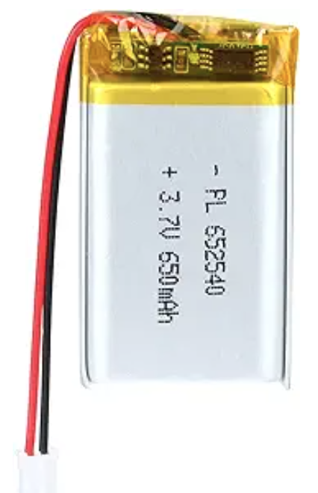
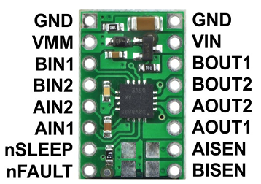
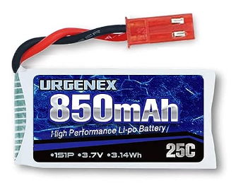
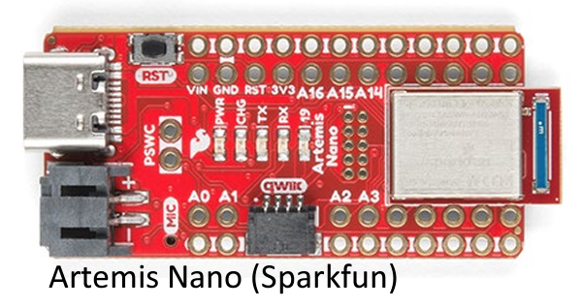
DC
motor1
DC
motor2

Slide 2
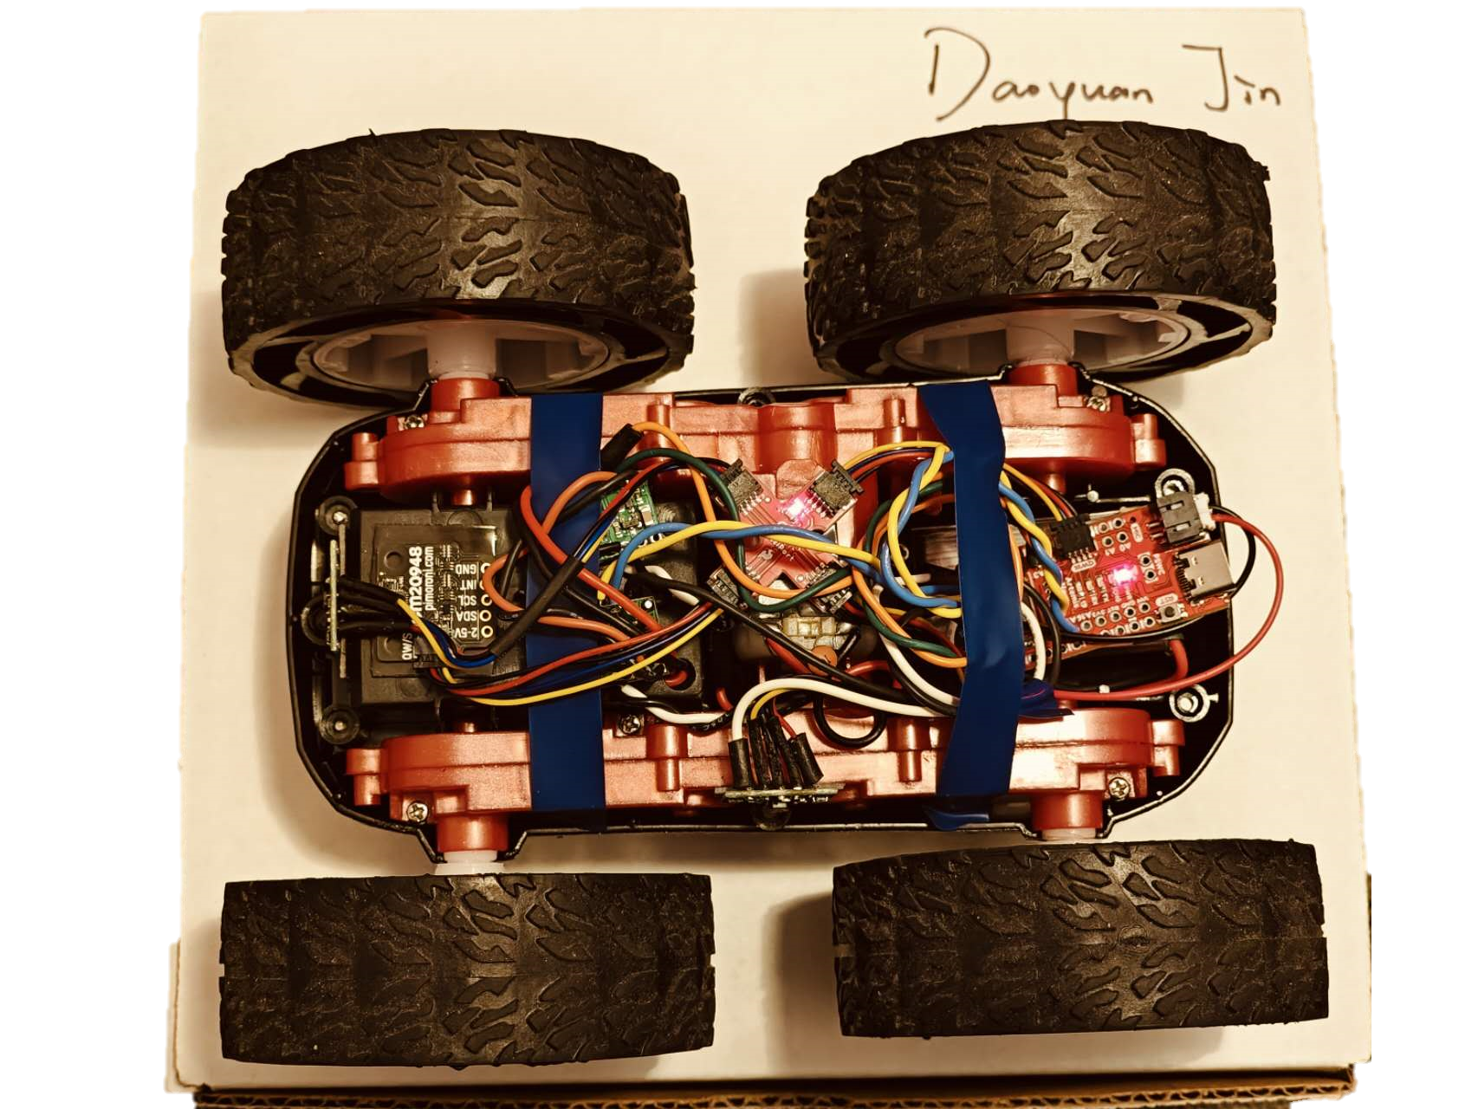
Motor
Driver 1
Breakout board
IMU
Artemis board
ToF 1
Battery 1
(back)
Battery 2
(back)
Motor
Driver 2
ToF 2

